Slide 1
CS 643, F ‘19: Cloud Computing
Databases in the Cloud
Kejul Vyas
Namita Agarwal
Charanpreet Kaur Dhir

Slide 2
Outline
Introduction to Cloud Database
DBaaS
Layered Architecture of Cloud Database Management System
Relational SQL: OLTP, OLAP
No SQL
How to choose cloud database
Notes:
om a structural and design perspective, a cloud database is no different than one that operates on a business's own on-premises servers. The critical difference lies in where the database resides.
Cloud computing databases are extremely popular for reducing IT complexities and operational costs. They prevent the hassle of licensing, traditional procurement, maintenance, and installation involving a huge number of IT staff. With the rapid increase in the business pace, cloud databases enable organizations to cut down on the in-house IT resources required to manage huge sets of data.

Slide 3
What is Cloud Database
Definition:
A cloud database is a collection of informational content, either structured or unstructured, that resides on a private, public or hybrid cloud computing infrastructure platform
It serves many of the same functions as a traditional database with the added flexibility of cloud computing
Key features:
A database service built and accessed through a cloud platform
Enables enterprise users to host databases without buying dedicated hardware
Can be managed by the user or offered as a service and managed by a provider
Can support SQL (including MySQL) or NoSQL databases
Accessed through a web interface or vendor-provided API
Notes:
om a structural and design perspective, a cloud database is no different than one that operates on a business's own on-premises servers. The critical difference lies in where the database resides.
Cloud computing databases are extremely popular for reducing IT complexities and operational costs. They prevent the hassle of licensing, traditional procurement, maintenance, and installation involving a huge number of IT staff. With the rapid increase in the business pace, cloud databases enable organizations to cut down on the in-house IT resources required to manage huge sets of data.

Slide 4
Motivation of Cloud Database
Ease of access: Users can access cloud databases from virtually anywhere, using a vendor’s API or web interface
Scalability: Cloud databases can expand their storage capacities at run-time to accommodate changing needs. Organizations only pay for what they use
Disaster recovery: In the event of a natural disaster, equipment failure or power outage, data is kept secure through backups on remote servers

Slide 5
Considerations Cloud Database
Control options Users can opt for a virtual machine image managed like a traditional database or a provider’s database as a service (DBaaS)
Database technology SQL databases are difficult to scale but very common. NoSQL databases scale more easily but do not work with some applications
Security Most cloud database providers encrypt data and provide other security measures; organizations should research their options
Maintenance When using a virtual machine image, one should ensure that IT staffers can maintain the underlying infrastructure

Slide 6
Examples of Cloud Databases
Amazon Web Services
Amazon RDS runs on either Oracle, SQL or MySQL
Amazon SimpleDB is primarily a schema-less database that is meant to handle smaller workloads
Amazon DynamoDB falls on the NoSQL databases
Redshift – a data integrating service for easier data management
SAP
Cloud database platform called HANA, which includes Sybase
3. Cloud SQL by Google
Cloud SQL, a relational database
Big Query, an analysis tool
4. Azure by Microsoft
Relational database

Slide 7
Types of Cloud DataBases
Virtual Machine Image:
Self-managed cloud database on Virtual Machine. Tasks of database oversight and management fall upon IT staffers of the organization
Database-as-a-Service (DBaaS):
In a classic DBaaS arrangement, the provider maintains the physical infrastructure and database, leaving the customer to manage the database content and operation
Notes:
Virtual machine image
Cloud platforms allow users to purchase virtual-machine instances for a limited time, and one can run a database on such virtual machines. Users can either upload their own machine image with a database installed on it, or use ready-made machine images that already include an optimized installation of a database.
Database-as-a-service (DBaaS)
With a database as a service model, application owners do not have to install and maintain the database themselves. Instead, the database service provider takes responsibility for installing and maintaining the database, and application owners are charged according to their usage of the service. This is a type of Saas - Software as a Service.

Slide 8
Outline
Introduction to Cloud Database
DBaaS
Layered Architecture of Cloud Database Management System
Relational SQL: OLTP, OLAP
No SQL
How to choose cloud database
Notes:
om a structural and design perspective, a cloud database is no different than one that operates on a business's own on-premises servers. The critical difference lies in where the database resides.
Cloud computing databases are extremely popular for reducing IT complexities and operational costs. They prevent the hassle of licensing, traditional procurement, maintenance, and installation involving a huge number of IT staff. With the rapid increase in the business pace, cloud databases enable organizations to cut down on the in-house IT resources required to manage huge sets of data.

Slide 9
Database-as-a-Service (DBaaS)
Definition:
DBaaS is a cloud computing service model that provides users with some form of access to a database without the need for setting up physical hardware, installing software or configuring for performance
All of the administrative tasks and maintenance are taken care of by the service provider so that all the user or application owner needs to do is use the database
Key Characteristics of DBaaS:
Self-service. DBaaS allows database consumers from various backgrounds and IT experience to provision databases effortlessly
On-demand. You pay for what you use, generating overall IT savings
Dynamic. Delivers a flexible database platform that tailors itself to the current needs of the environment based on the resources available
Security. A team of experts at your disposal continuously monitoring your databases
Automation. Automates database administration and monitoring
Leverage. Leverages existing servers and storage
Notes:
"With a database as a service model, application owners do not have to install and maintain the database themselves. Instead, the database service provider takes responsibility for installing and maintaining the database, and application owners are charged according to their usage of the service. For example, Amazon Web Services provides three database as a service offerings as part of its cloud portfolio: SimpleDB, a NoSQL key-value store; Amazon RDS, a relational database service that includes support for MySQL, Oracle, and more; and DynamoDB. Microsoft offers its SQL Database service[3] on its Azure cloud service platform. Cloud computing platform Rackspace offers database as a service for MySQL and MongoDB. Database as a service providers are not limited to cloud computing platforms. For example, MongoDB as a service provider mLab allows their customers to host their databases on AWS, Azure, or Google Cloud Platform. Database vendors have also launched their own services under this model. Oracle provides its own database as a service, allowing users to access Oracle Database 11g and 12c as cloud services."

Slide 10
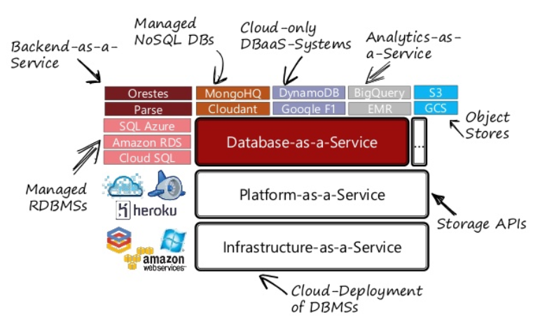
Database-as-a-Service (DBaaS)

Slide 11
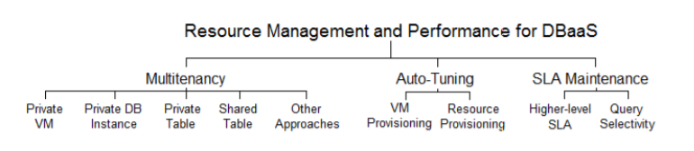
DBaaS Resource Management Classification

Slide 12
Multitenancy (1)
A single instance of a software application serves multiple customers, and each customer is called a tenant
A. Private Virtual Machine
Provides total isolation among tenants, since it virtualizes the physical machines where the databases are hosted on and it works for the tenant as it had a physical machine for itself
Can be used for each tenant in order to provide database replicas more easily and address the challenges of provisioning shared-nothing replicated databases in the cloud
B. Private DB Instance
Tenants are hosted on the same physical machine and can use the same disk and processing power
Microsoft Azure SQL Database uses this scheme to provide a relational database service in the cloud

Slide 13
Multitenancy (2)
C. Private Table
Tenants share the same database process, but each of them has their own tables
Allows tenants to share connection pools, enhancing the performance of executing commands on the database
Downside: vulnerability, as security has to be handled at the application laye
D. Shared Table
All the tenants share the same database process and the same tables, without schema separation
Cheapest of all approaches, with the lowest disk storage and the best pooling resources
Most scalable scheme and is limited only by the number of rows the database can hold
Optimization can become a big problem and security may be easily compromised

Slide 14
Auto-tuning
DB parameters and configuration of the operating system and hardware must be frequently optimized, in an automatic fashion, to improve the response latency for DB
A. Virtual Machine Provisioning
Live migration in a multitenant DB, where the database cache and state of active transactions are migrated to ensure minimal impact on transaction execution during migration
B. Resource Provisioning
An automated solution that achieves workload-specific DBMS tuning by observing multiple workloads running on a pool of machines, extracting performance/resource characteristics of each workload, and assigning them to a set of different tuned DBMSs
Notes:
Using schemes has a lower complexity over not using them, since the SQL statements can be the same, only redirecting to the correct schema, and also backup and migration scripts can be reused. This approach is better than the previous ones at pooling memory, where studies indicate that it can scale up to thousands of active tenants per server, a two orders of magnitude improvement over the shared machine approach.

Slide 15
Outline
Introduction to Cloud Database
DBaaS
Layered Architecture of Cloud Database Management System
Relational SQL: OLTP, OLAP
No SQL
How to choose cloud database
Notes:
om a structural and design perspective, a cloud database is no different than one that operates on a business's own on-premises servers. The critical difference lies in where the database resides.
Cloud computing databases are extremely popular for reducing IT complexities and operational costs. They prevent the hassle of licensing, traditional procurement, maintenance, and installation involving a huge number of IT staff. With the rapid increase in the business pace, cloud databases enable organizations to cut down on the in-house IT resources required to manage huge sets of data.

Slide 16
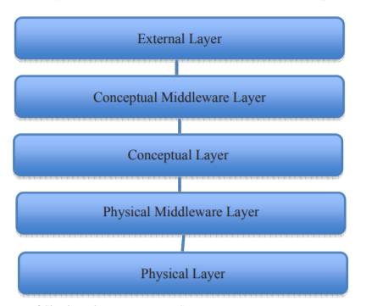
Layered Architecture of Cloud Database Management System (1)

Slide 17
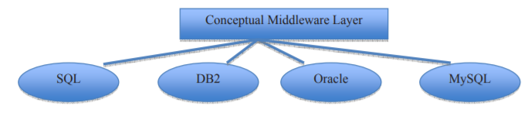
Layered Architecture of Cloud Database Management System (2)
External Layer
Presented to users
Main function of the service provider is to manage and provide the services with full transparency and security
Conceptual Middleware Layer
Hides the conceptual level heterogeneity among different databases like SQL, DB2, Oracle etc.
Provides interoperability; operate irrespective of their underlying databases.

Slide 18
Layered Architecture of Cloud Database Management System (3)
Conceptual Layer
Represents the logical structure of the entire database and deals with the internal processing on data
Deals with the issues such as which one of the various types of query languages or which one of the available programming techniques, which one of the different query optimization techniques should be used for Cloud DBMS
Physical Middleware Layer
Hides heterogeneity across different OSs
Physical Layer
This layer represents the physical representation of the data.
Responsible for the continuous monitoring and configuring of the database to achieve optimal scaling, high availability, multi-tenancy and effective resource allocation in the cloud
Handles data security, privacy, partitioning, shared disk architecture or shared nothing architecture

Slide 19
Common DB Challenges in the Cloud
Size Limitations: enterprise-level databases need the ability to grow over time.
Data Protection: Cloud volumes allows you to protect your data with point-in-time snapshot copies of your database.
Storage Performance
In the public cloud, performance of your storage layer is often tied to how much capacity you provision
Either over-provision your capacity in order to get the performance you require or opt for more expensive provisioned performance storage options
If workloads have large performance spikes, the storage you require might increase costs significantly

Slide 20
Outline
Introduction to Cloud Database
DBaaS
Layered Architecture of Cloud Database Management System
Relational SQL: OLTP, OLAP
No SQL
How to choose cloud database
Notes:
om a structural and design perspective, a cloud database is no different than one that operates on a business's own on-premises servers. The critical difference lies in where the database resides.
Cloud computing databases are extremely popular for reducing IT complexities and operational costs. They prevent the hassle of licensing, traditional procurement, maintenance, and installation involving a huge number of IT staff. With the rapid increase in the business pace, cloud databases enable organizations to cut down on the in-house IT resources required to manage huge sets of data.

Slide 21
Relational SQL: OLTP and OLAP
OLTP (Online Transaction Processing)
Characterized by a large number of short online transactions (INSERT, UPDATE, DELETE)
Emphasis put on very fast query processing, maintaining data integrity in multi-access environments and transactions per second
OLAP (Online Analytical Processing)
Characterized by relatively low volume of transactions
Queries are often very complex and involve aggregations
Response time is a measure of effectiveness measure
Applications: Data Mining techniques
Notes:
we can assume that OLTP systems provide source data to data warehouses, whereas OLAP systems help to analyze it.
- OLTP (On-line Transaction Processing) is characterized by a large number of short on-line transactions (INSERT, UPDATE, DELETE). The main emphasis for OLTP systems is put on very fast query processing, maintaining data integrity in multi-access environments and an effectiveness measured by number of transactions per second. In OLTP database there is detailed and current data, and schema used to store transactional databases is the entity model (usually 3NF). It involves Queries accessing individual record like Update your Email in Company database.
- OLAP (On-line Analytical Processing) is characterized by relatively low volume of transactions. Queries are often very complex and involve aggregations. For OLAP systems a response time is an effectiveness measure. OLAP applications are widely used by Data Mining techniques. In OLAP database there is aggregated, historical data, stored in multi-dimensional schemas (usually star schema).Sometime query need to access large amount of data in Management records like what was the profit of your company in last year.
https://techdifferences.com/difference-between-oltp-and-olap.html
https://www.datawarehouse4u.info/OLTP-vs-OLAP.html

Slide 22
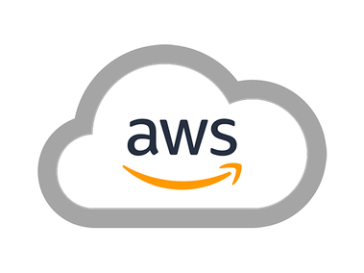
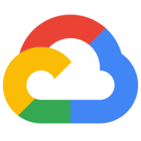
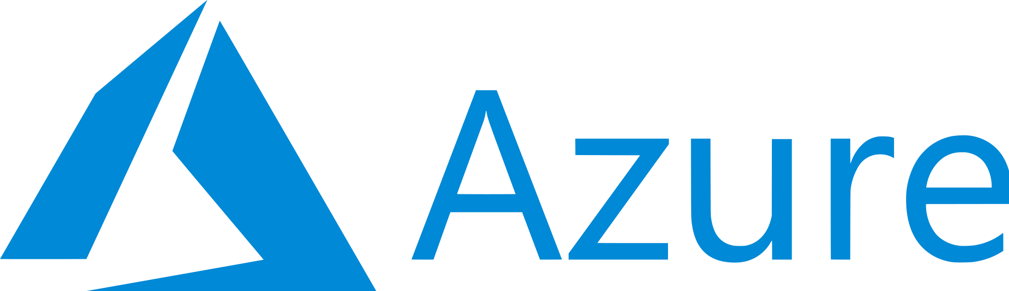
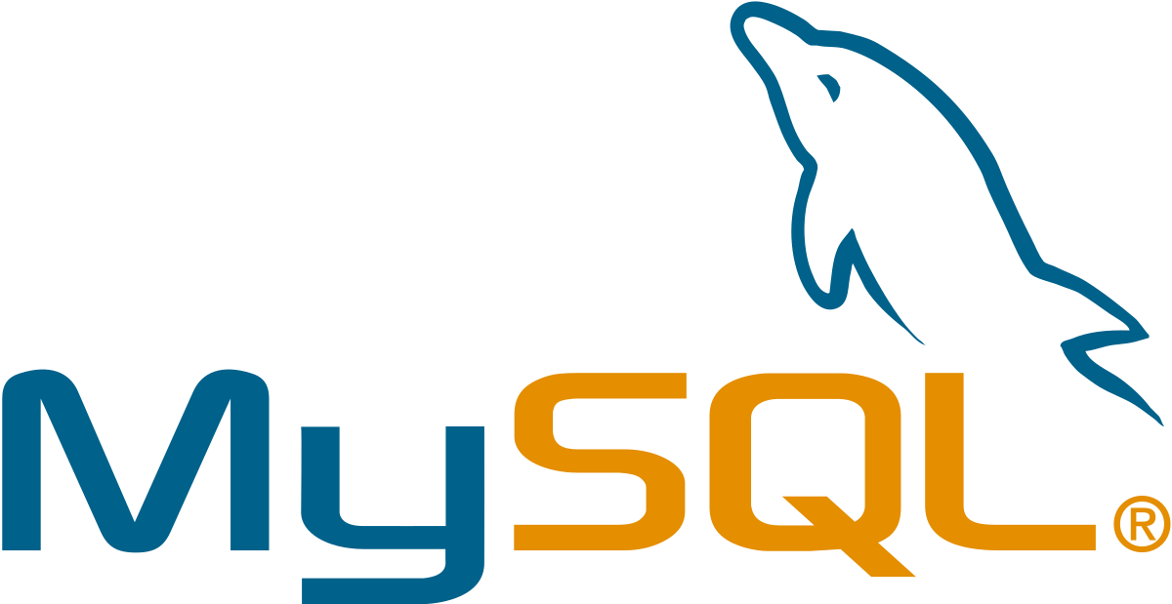
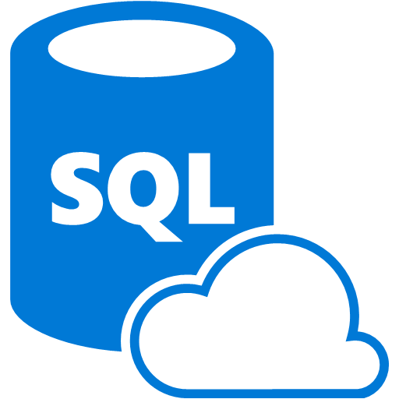
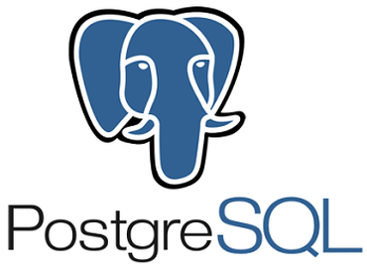
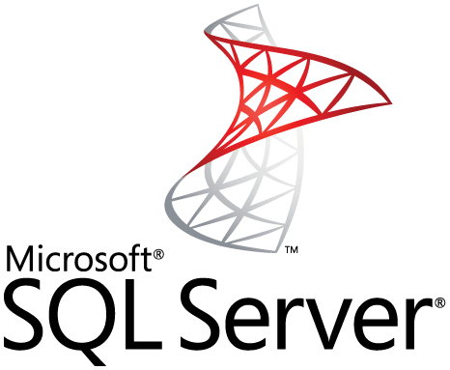
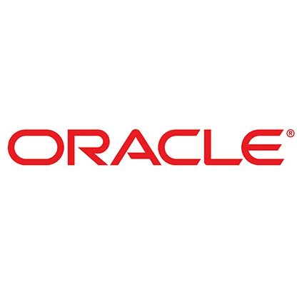
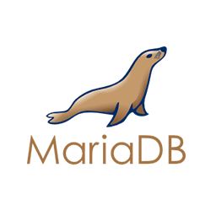
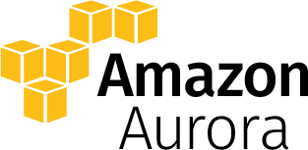
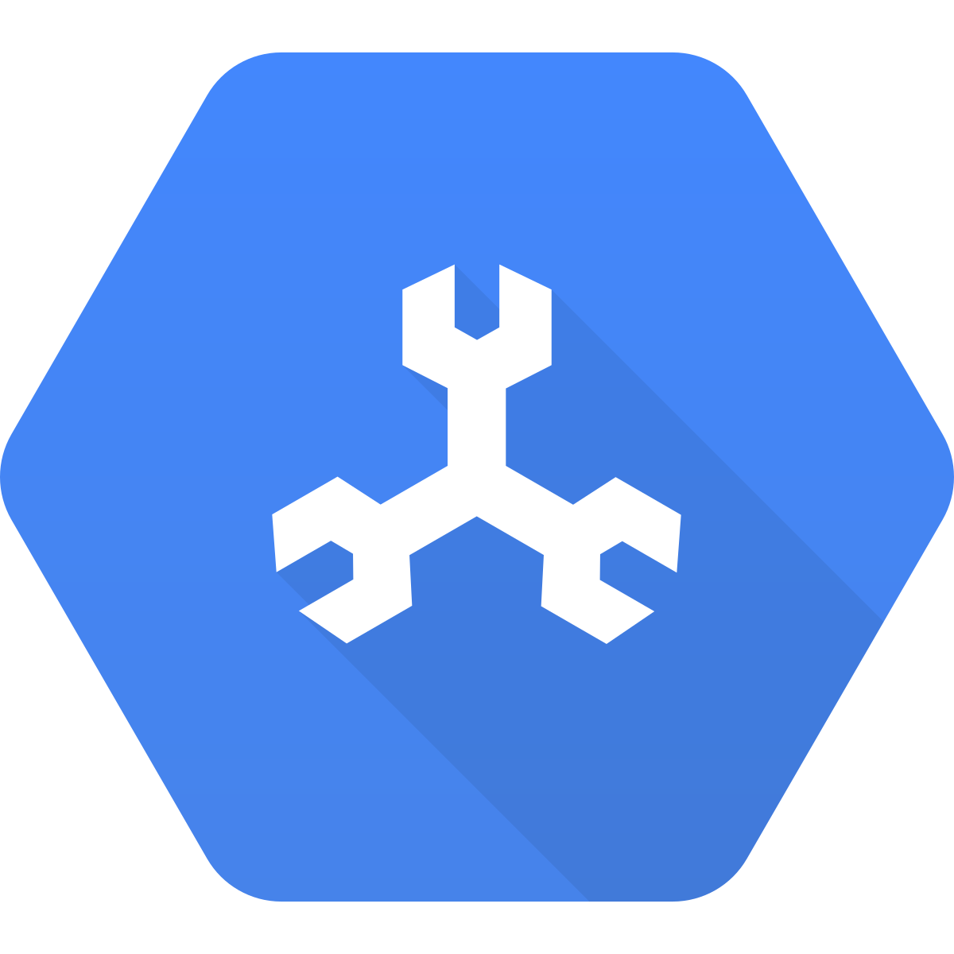
OLTP in the Cloud
Type of databases
Traditional Enterprise Databases
Distributed, Scalable and High Performance Databases
Notes:
https://aws.amazon.com/rds/

Slide 23

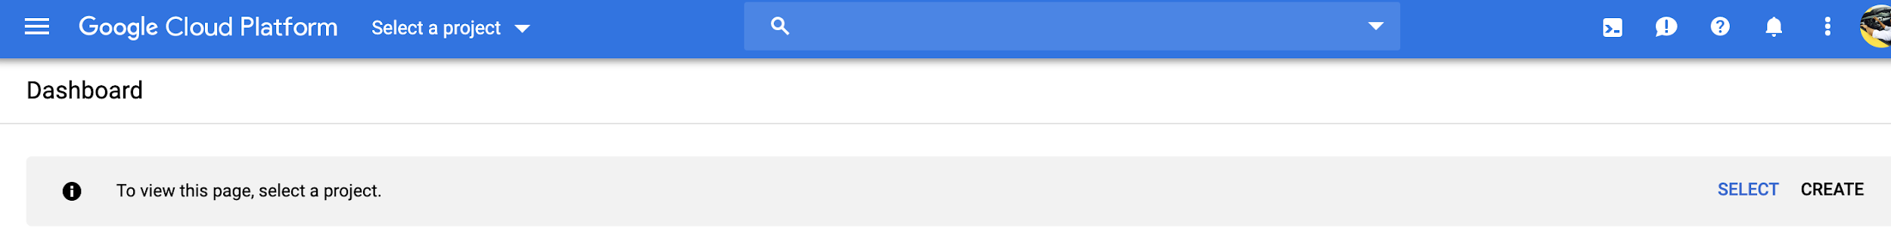
OLTP: Using MySQL in Google Cloud (1)
Before you begin
Select or create a GCP project.

Slide 24

OLTP: Using MySQL in Google Cloud (2)
2. Create an instance
Select your project and click Continue.
Click Create Instance.

Slide 25
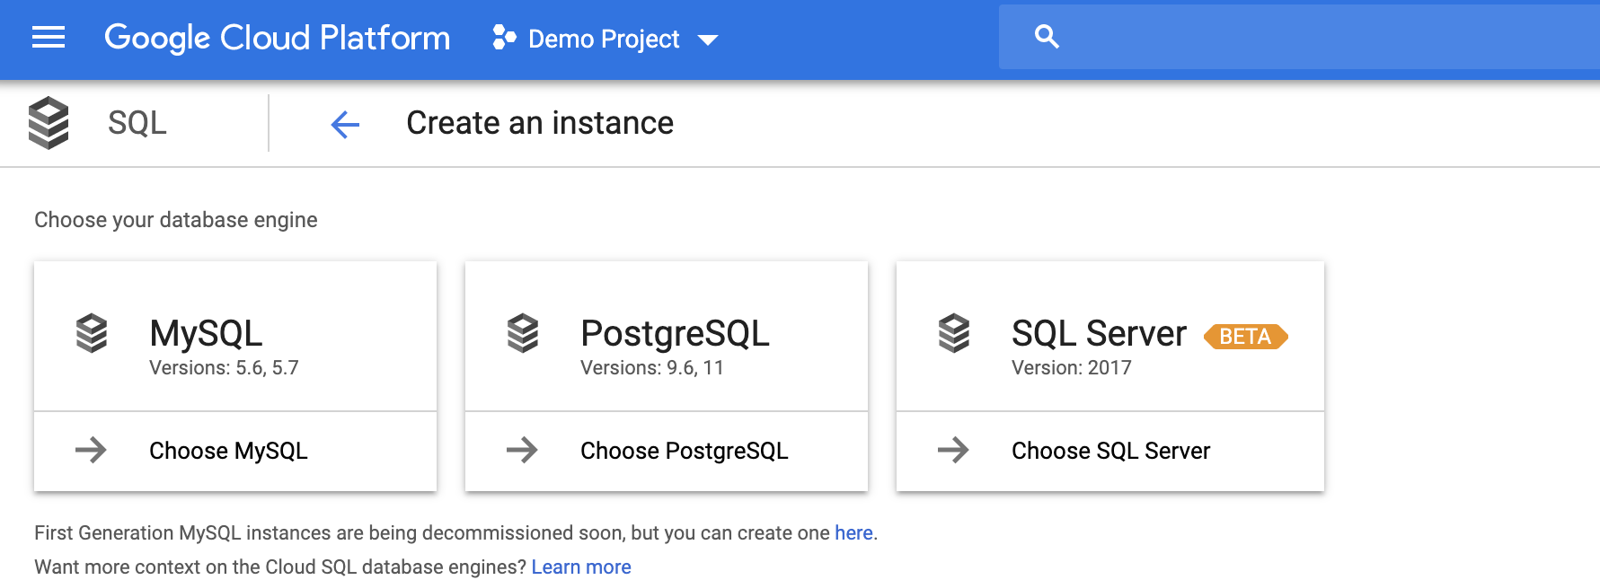
OLTP: Using MySQL in Google Cloud (3)
3. Click MySQL

Slide 26
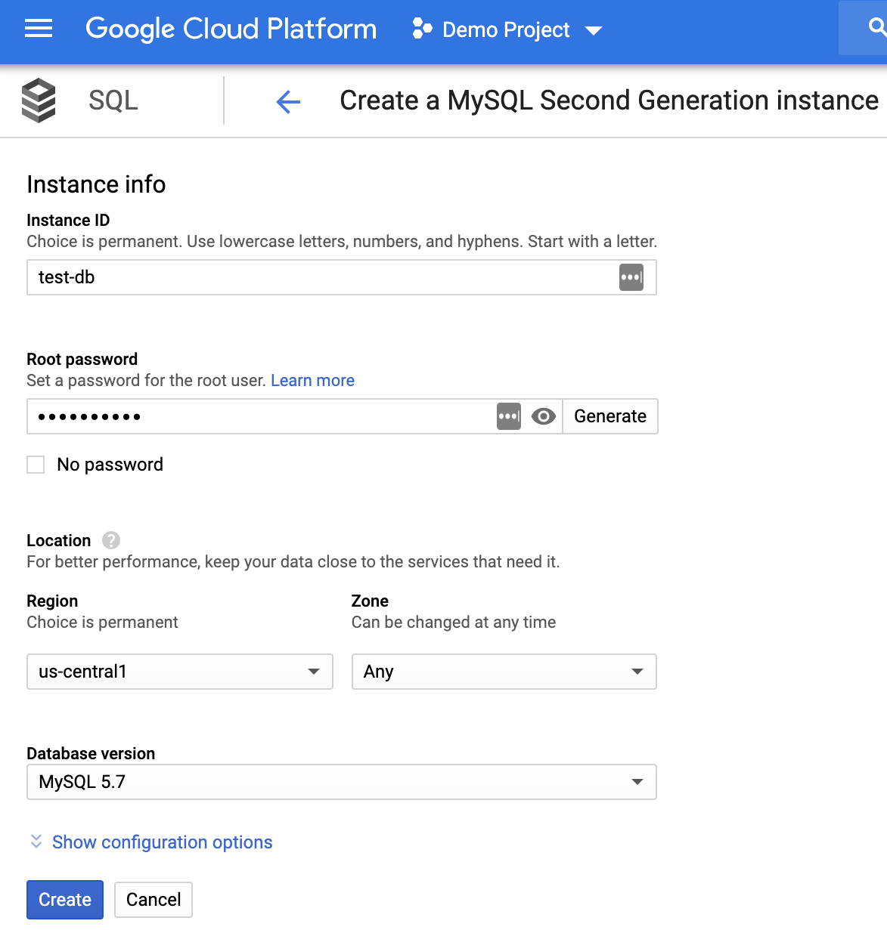
OLTP: Using MySQL in Google Cloud (4)
4. Enter Instance ID.

Slide 27

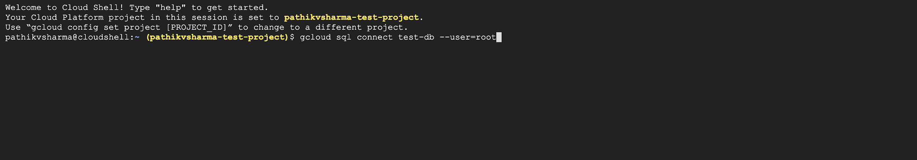
OLTP: Using MySQL in Google Cloud (5)
In the Google Cloud Platform Console, click the Cloud Shell icon in the upper right corner.
2. At the Cloud Shell prompt, connect to your Cloud SQL instance:

Slide 28
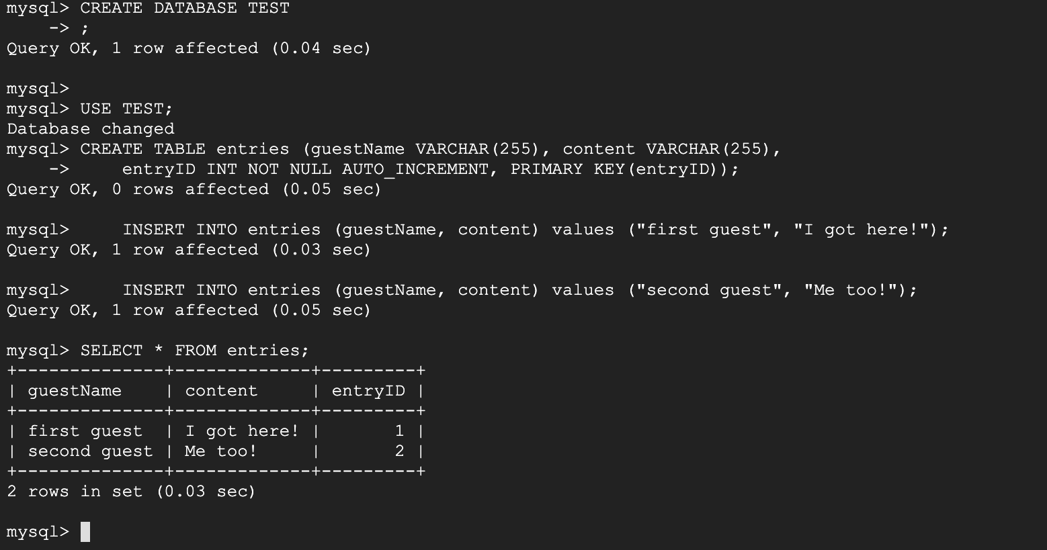
OLTP: Using MySQL in Google Cloud (6) Create a database and upload data
Create a SQL database on your Cloud SQL instance:
Insert sample data into the guestbook database:
Retrieve the data:

Slide 29
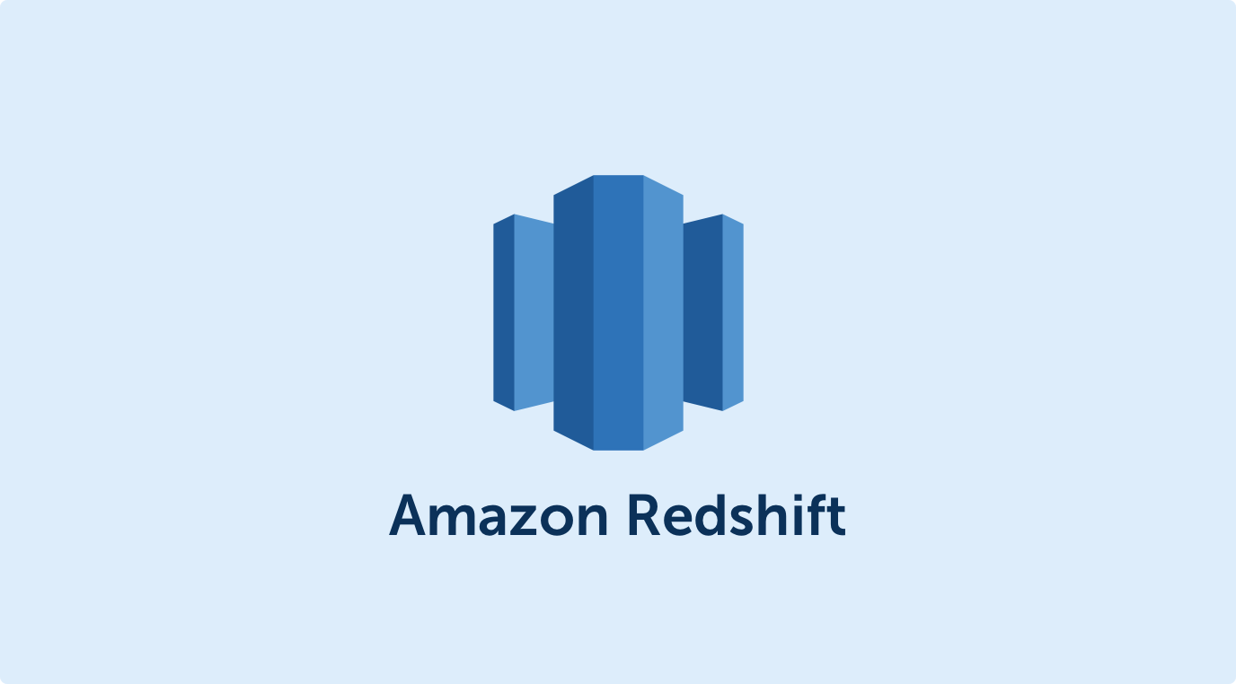
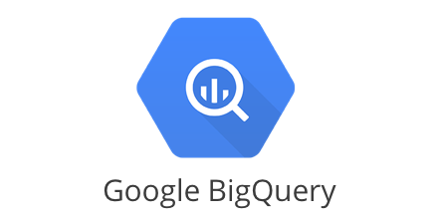
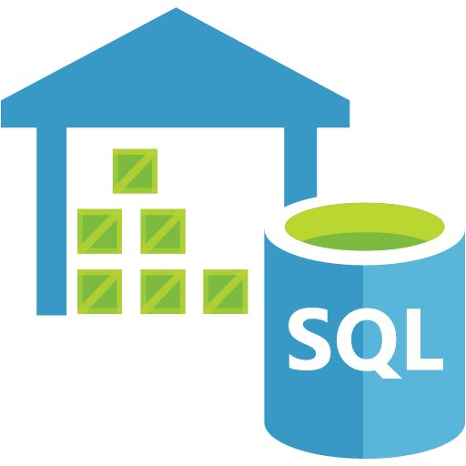
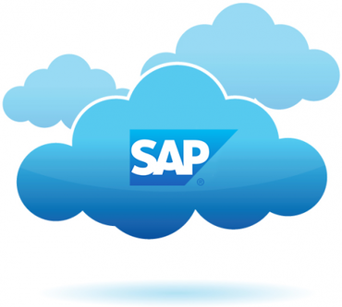
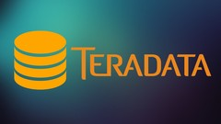
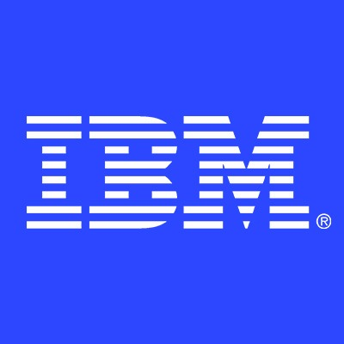

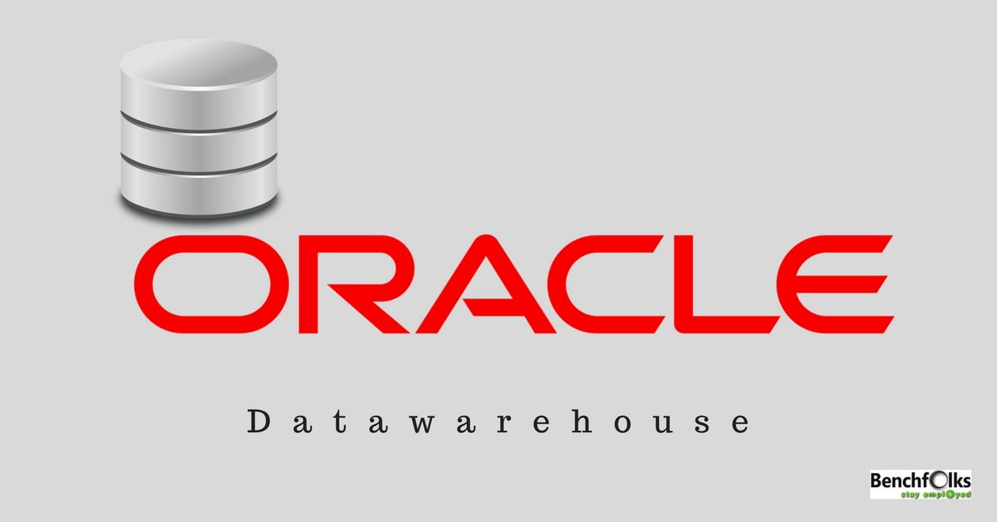
OLAP in the Cloud
Type of databases
Traditional Data Warehouses |  |  | SQL Data Warehouse
Other Vendors

Slide 30

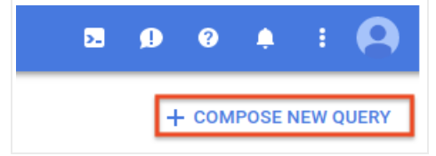
OLAP: Using Google’s BigQuery to query a public dataset (1)
Go to the BigQuery web UI in the GCP Console.
At the top right of the window, click Compose new query. If this text is dimmed, then the Query editor is already open.

Slide 31
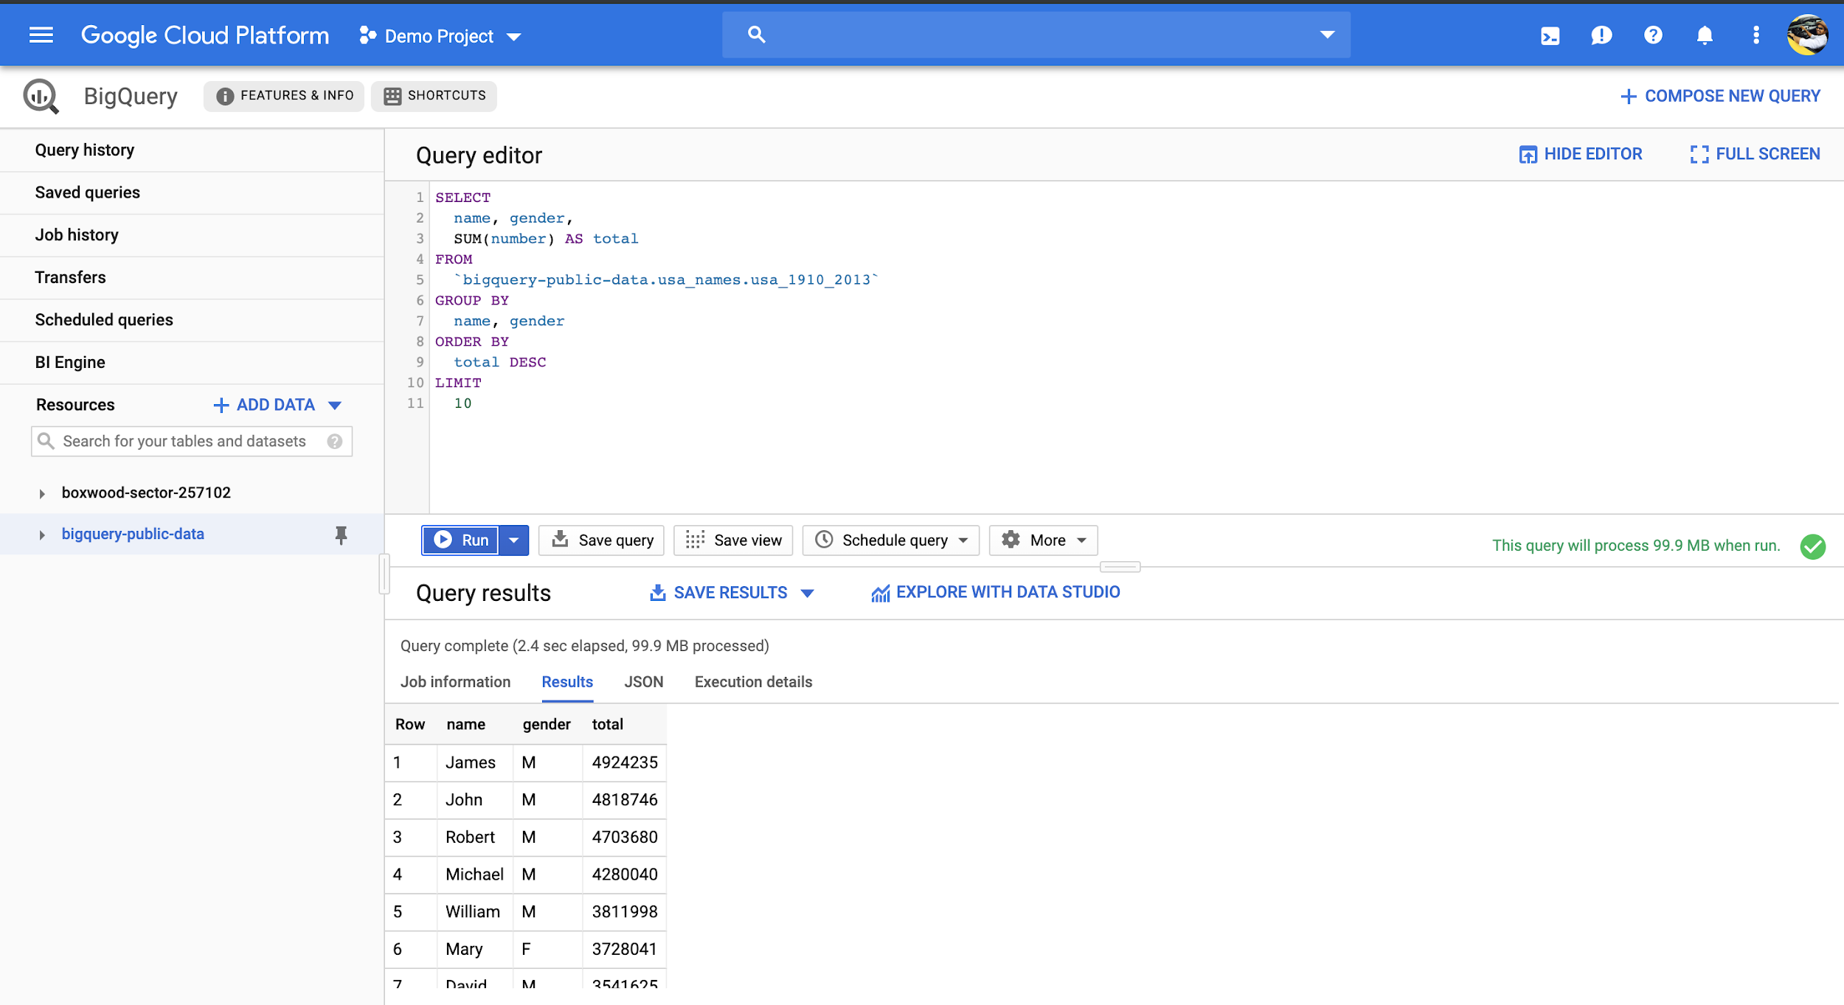
OLAP: Using Google’s BigQuery to query a public dataset (2)
In this example, you query the USA Name Data public dataset to determine the most common names in the US between 1910 and 2013.
Notes:
In this example, you query the USA Name Data public dataset to determine the most common names in the US between 1910 and 2013.

Slide 32
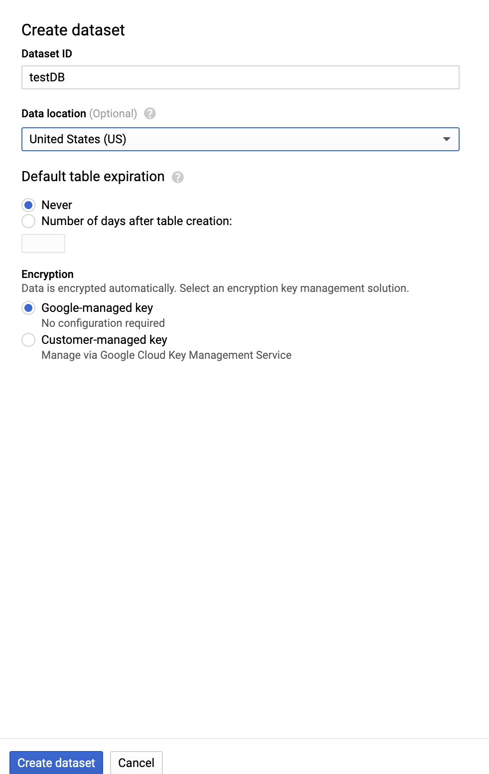
OLAP: Using Google’s BigQuery to load data into a table (1)
Notes:
In the navigation panel, in the Resources section, click your project name.
On the right side, in the details panel, click Create dataset.

Slide 33
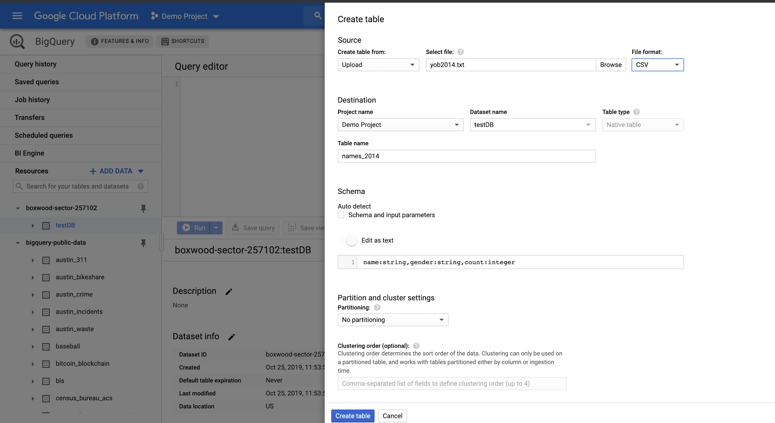
OLAP: Using Google’s BigQuery to load data into a table (2)
Notes:
In the navigation panel, in the Resources section, click the babynames dataset that you just created.
On the right side, in the details panel, click Create table. Use the default values for all settings unless otherwise indicated.
On the Create table page:

Slide 34
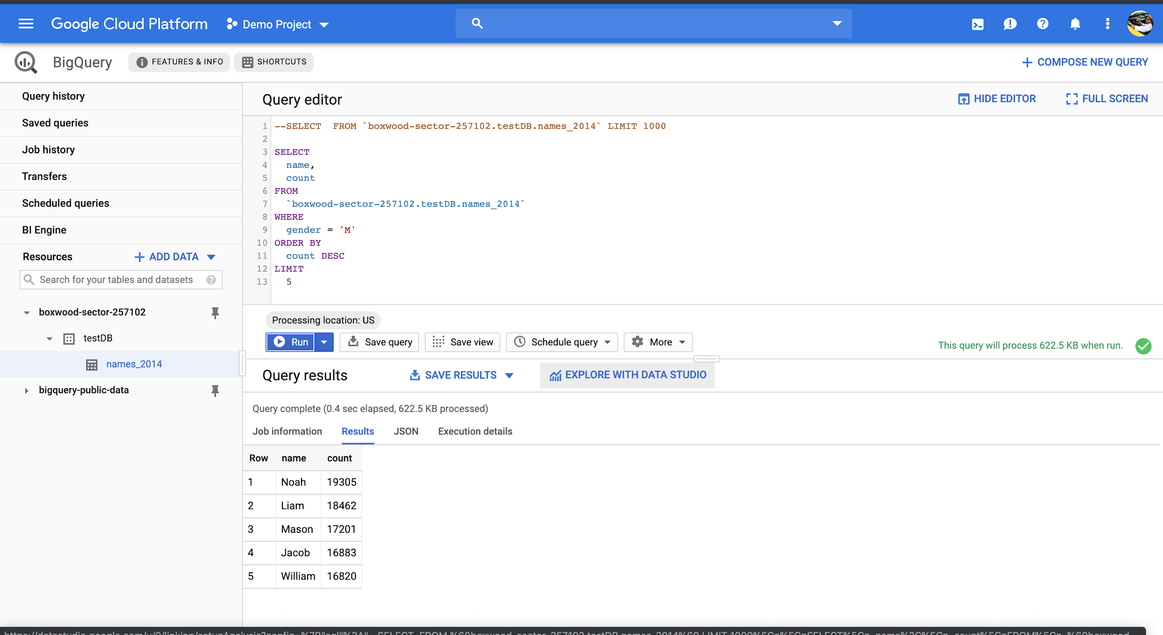
OLAP: Using Google’s BigQuery to load data into a table (3)
Notes:
Preview the table
Query the table

Slide 35
Outline
Introduction to Cloud Database
DBaaS
Layered Architecture of Cloud Database Management System
Relational SQL: OLTP, OLAP
No SQL
How to choose cloud database
Notes:
om a structural and design perspective, a cloud database is no different than one that operates on a business's own on-premises servers. The critical difference lies in where the database resides.
Cloud computing databases are extremely popular for reducing IT complexities and operational costs. They prevent the hassle of licensing, traditional procurement, maintenance, and installation involving a huge number of IT staff. With the rapid increase in the business pace, cloud databases enable organizations to cut down on the in-house IT resources required to manage huge sets of data.

Slide 36
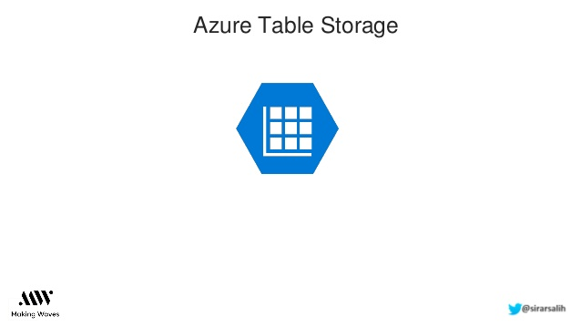
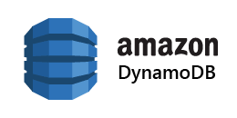
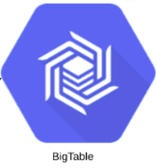
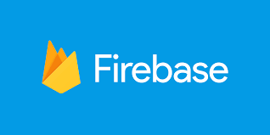
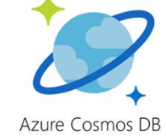
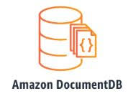

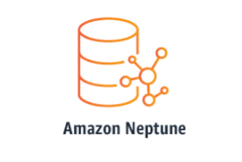
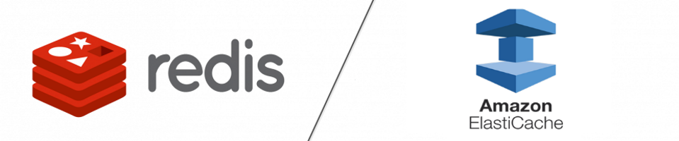
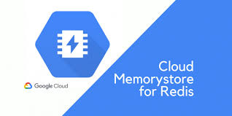
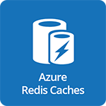
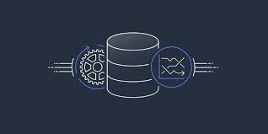
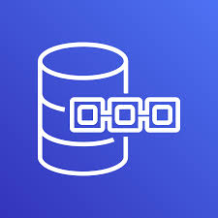
No SQL DBs: Non Relational SQL
Types of NoSQL Databases | AWS | GCP | AZURE
Key value/Column based
Document
Graph
In Memory
Time series Ledger
Other Vendors | Key Value/Column based : Cassandra, HBase, Oracle NoSQL Document based: CouchDB, MongoDB Graph based: Neo4J

Slide 37
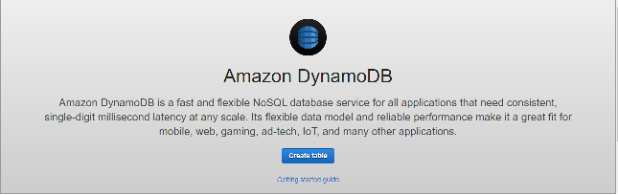
How to create a table in DynamoDB (1)

Slide 38
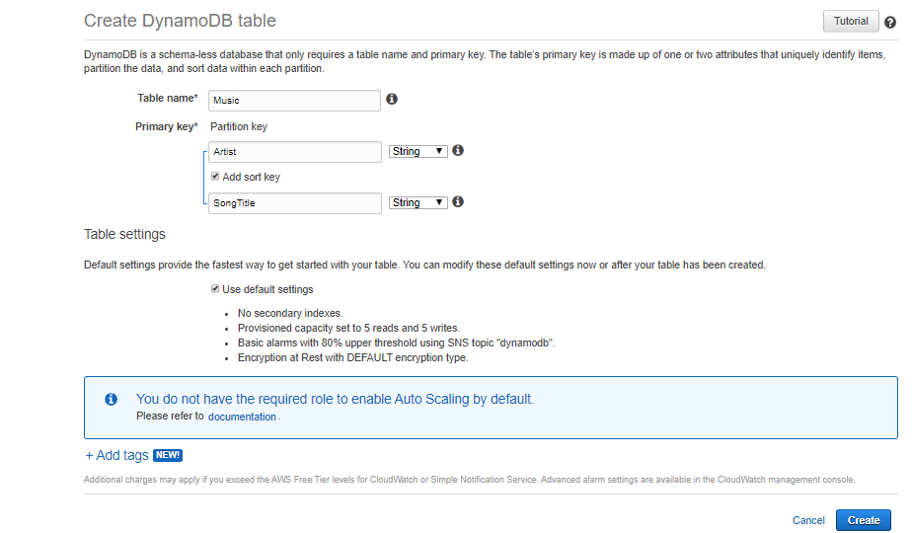
How to create a table in DynamoDB (2)
Music library as use case
In the table name type “Music”, in the partition key type ”Artist”, add a sort key “SongTitle, and then click “Create”.

Slide 39
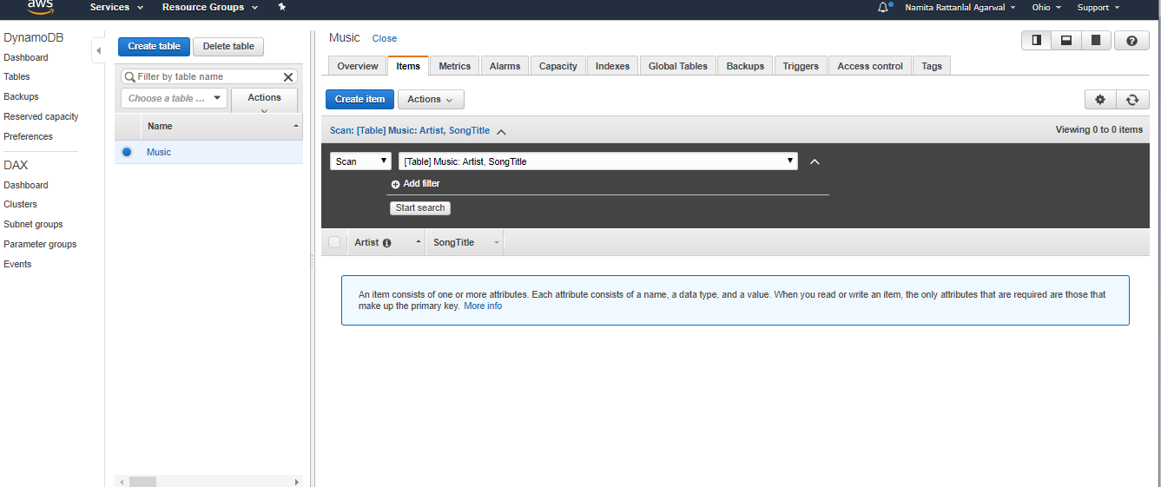
How to add data to a table in DynamoDB (1)
Select the “Items” tab and choose “Create Item”

Slide 40
How to add data to a table in DynamoDB (2)
In the data entry window type the following and add items to the table:
For Artist attribute type: Sia
For SongTitle attribute type: Cheap Thrills
For Artist attribute type: Sia
For SongTitle attribute type: Beautiful People
For Artist attribute type: Rihanna
For SongTitle attribute type: Diamonds

Slide 41
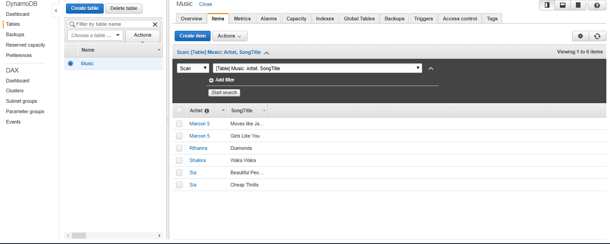
How to add data to a table in DynamoDB (3)

Slide 42
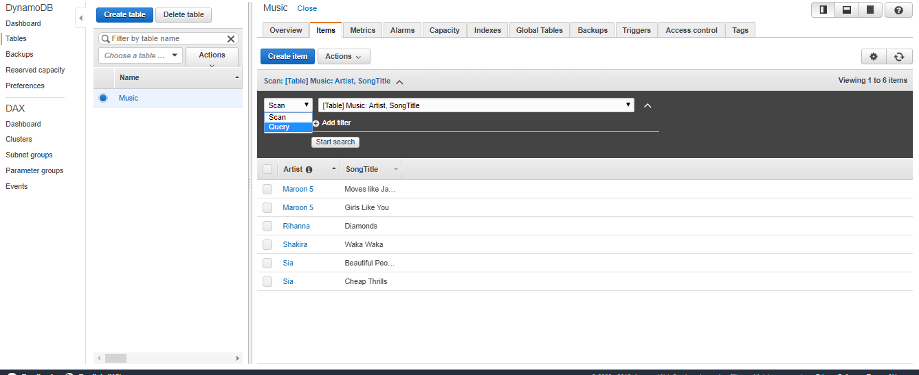
How to query data in DynamoDB (1)
In the drop down list below the “create item” tab, change “scan” to “query”

Slide 43
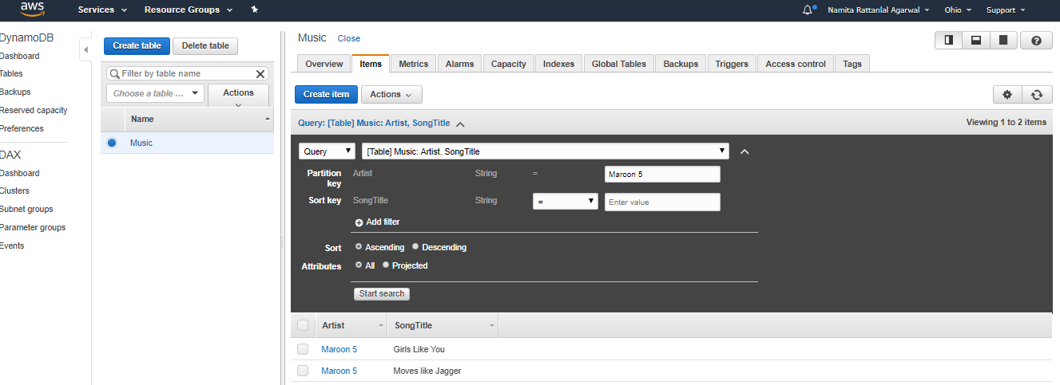
How to query data in DynamoDB (2)
In the “Artist” box type “Maroon 5” and select “start search”

Slide 44
Outline
Introduction to Cloud Database
DBaaS
Layered Architecture of Cloud Database Management System
Relational SQL: OLTP, OLAP
No SQL
How to choose cloud database
Notes:
om a structural and design perspective, a cloud database is no different than one that operates on a business's own on-premises servers. The critical difference lies in where the database resides.
Cloud computing databases are extremely popular for reducing IT complexities and operational costs. They prevent the hassle of licensing, traditional procurement, maintenance, and installation involving a huge number of IT staff. With the rapid increase in the business pace, cloud databases enable organizations to cut down on the in-house IT resources required to manage huge sets of data.

Slide 45
How to choose cloud database
Choosing a DB is based on the following factors:
Availability zones
Market share
DB and Storage Services provided
Downtime
Pricing and billing models

Slide 46



Availability Zones of Azure/AWS/GCP

Slide 47

Market Share of Public Cloud Providers

Slide 48

DB Services Provided

Slide 49

Storage Services Provided

Slide 50

Downtime of Public Cloud Providers

Slide 51



Pricing and Billing Models for Public Cloud Providers (1)
2vCPUs+ 8GB RAM
~69 USD/month
Largest instance offered by AWS
3.84TB RAM +128vCPUS
$3.97/hour
2vCPUs+ 8GB RAM
~70 USD/month
Largest instance offered by Azure
3.89TB RAM +128vCPUS
$6.79/hour
2vCPUs+ 8GB RAM
~52 USD/month
Largest instance offered by GCP
3.75TB RAM +160vCPUS
$5.32/hour

Slide 52




Pricing and Billing Models for Public Cloud Providers (2)

Slide 53
Thank You

